Slide 1





Complete Selenium Automation Engineer Bootcamp: Go from Zero to Hero

Slide 2
OOP(Object Oriented Programming)
OOP – Programming Language Model organized around objects rather than “actions” and data rather than logic.
Logical procedure that takes input data, processes it, and produces output data.
In OOP, Everything is an object just like real world.
OOP Types
Encapsulation
Inheritance
Polymorphism
Overriding
Abstraction
Interfaces

Slide 3
Encapsulation
Process of packing of data and functions into a single component.
Internal representation of an object hidden from outside.
Variables of a class will be hidden from other classes, and can be accessed only through the methods of their current class.
Can be used in order to prevent modification of variables from objects.
To achieve encapsulation in java
Declare the variables of class as private
Provide public getter and setter methods to modify and view variables.

Slide 4
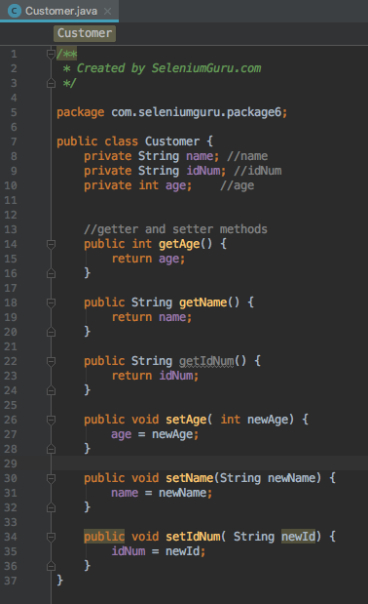
ENCAPSULATION - CONTD

Slide 5
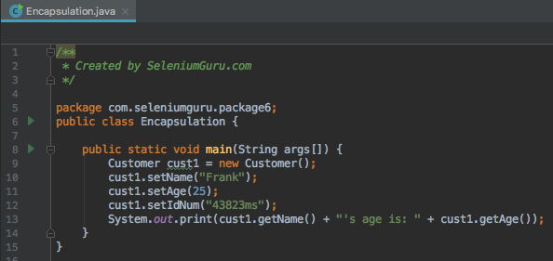
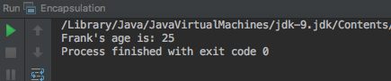
ENCAPSULATION - CONTD

Slide 6
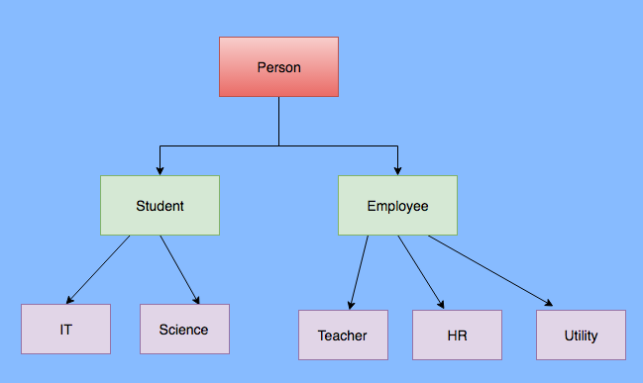
Inheritance
Relation between two classes where a child class inherits all features of its parent class.
Methods from the parent can be overridden in the child and new logic can be added.

Slide 7
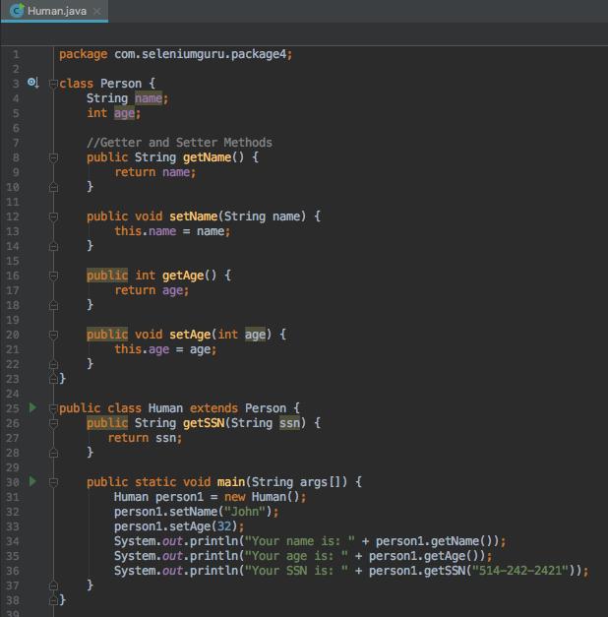
Inheritance Contd..

Slide 8
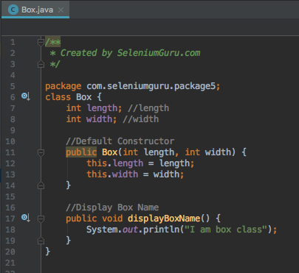
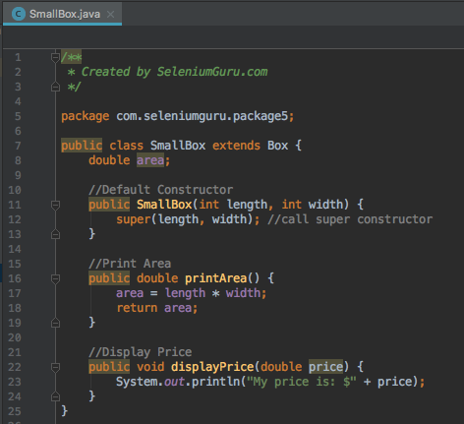
Inheritance Contd..

Slide 9
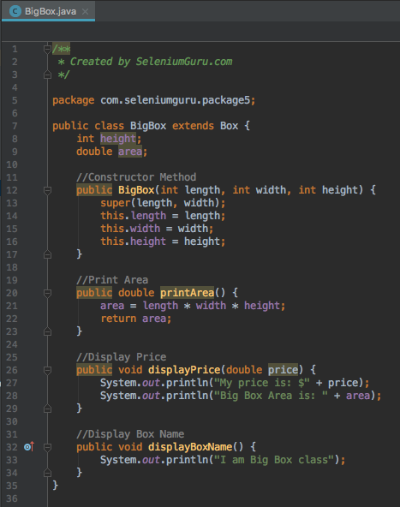
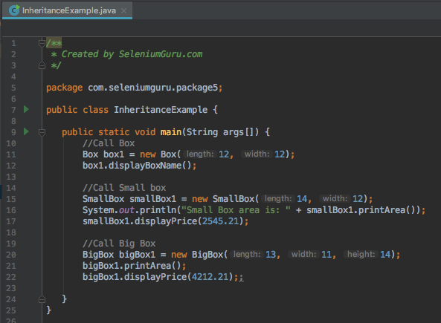
Inheritance Contd..

Slide 10
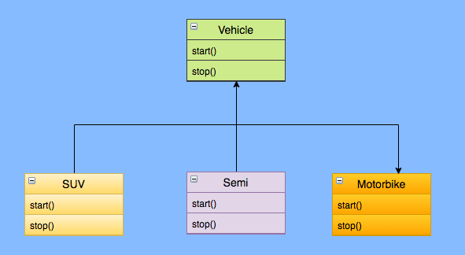
Polymorphism
Polymorphism derives from the Greek word “Poly” meaning much or many form or shape.
Polymorphism in programming refers to the ability to use same methods in different ways for different objects or data types.

Slide 11
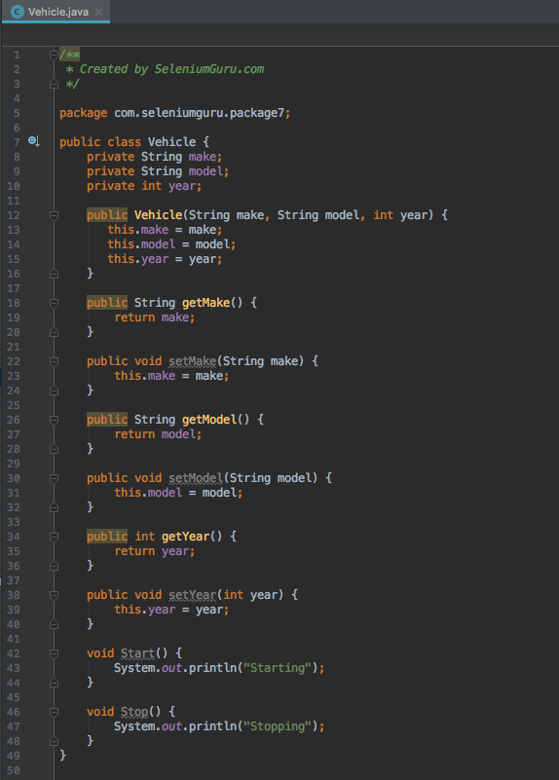
Polymorphism Contd..

Slide 12
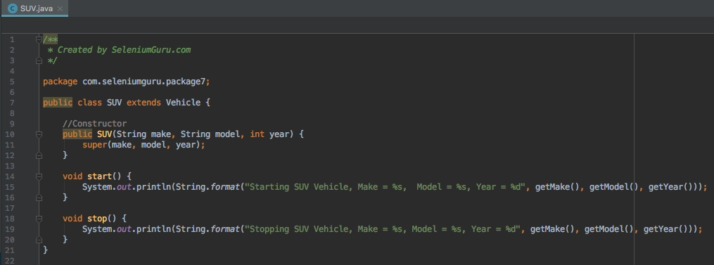
Polymorphism Contd..

Slide 13
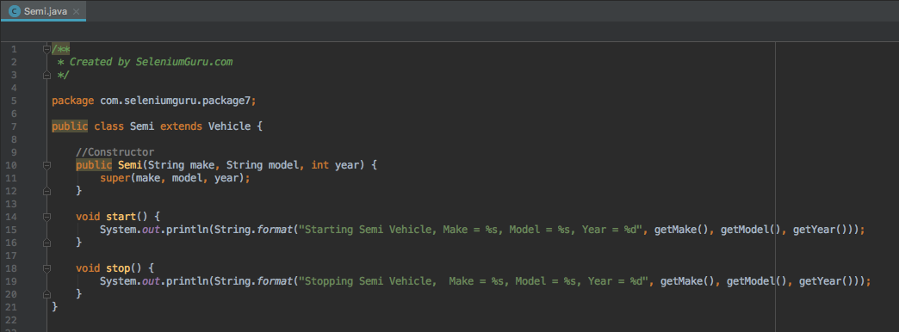
Polymorphism Contd..

Slide 14
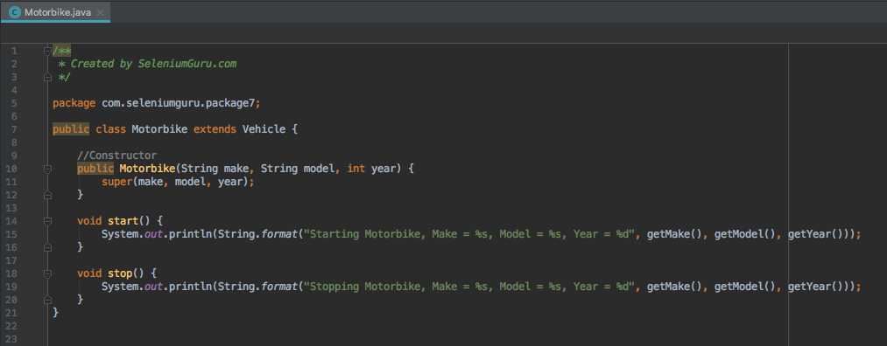
Polymorphism Contd..

Slide 15
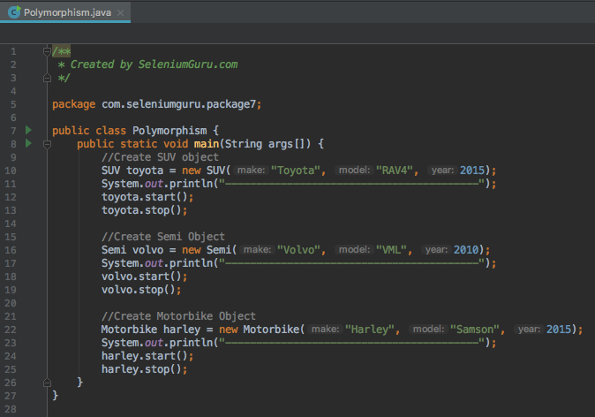
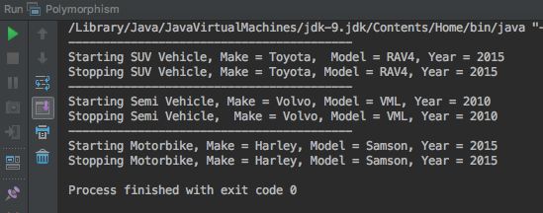
Polymorphism Contd..

Slide 16
Overriding
Overriding is ability to define a behavior that is specific to the subclass type, which means a subclass can implement a parent class method based on its requirement.
Overriding means to override the functionality of an existing method.
Overriding is normally done during inheritance where the parent class and sub class may have same method name and needs to be overridden based on the requirement.

Slide 17
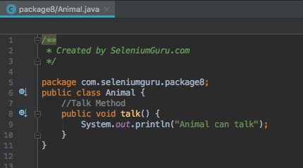
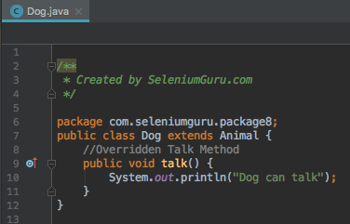
Overriding Contd..

Slide 18
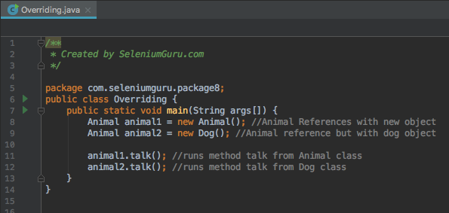
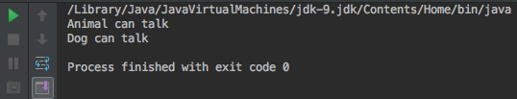
Overriding Contd..

Slide 19
Overloading
Overloading is ability to define a behavior that is specific to the subclass type, which means a subclass can implement a parent class method based on its requirement.
Overloading allows different methods to have same name, but different signature where signature can differ by number of input parameters or type of input parameters or both.
Overloading is normally done during inheritance where the parent class and sub class may have same method name but with different parameters or input type and needs to be overloaded based on the requirement.
Main advantage of Overloading is that you don’t have to create multiple methods for the same functionality if the functionality requires different parameters or input types.

Slide 20
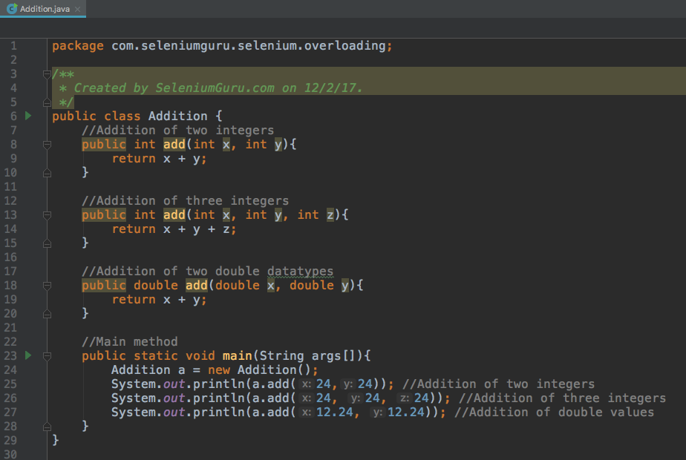
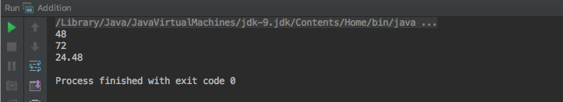
Overloading Contd..

Slide 21
Abstraction
Abstraction in java is process of hiding the implementation details from the user.
Only the functionality will be provided to the user.
Example of Abstraction is to pushing the button in your elevator. You do not need to know the details how it works but only need to know what button you need to press to go to your destination floor.
Abstraction in Java can be achieved using Abstract classes and interfaces.

Slide 22
Abstract Class
Abstract class is a class that is declared abstract.
Key features of Abstract methods
Abstract method may or may not contain abstract methods (methods without body).
Any abstract method in the class would require the class to be declared abstract.
If you inherit an abstract class, you have to provide implementations to all the abstract methods in it.
You have to inherit from another class if you want to use an abstract class and provide implementations.

Slide 23
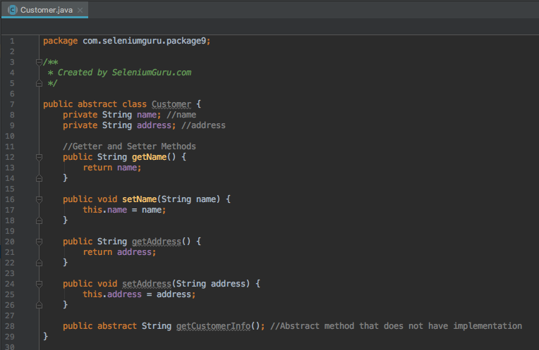
Abstract Class Contd..

Slide 24
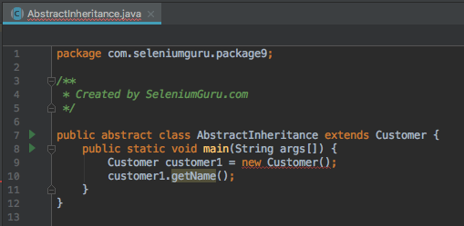
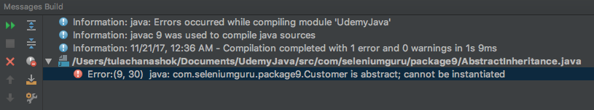
Abstract Class Contd..

Slide 25
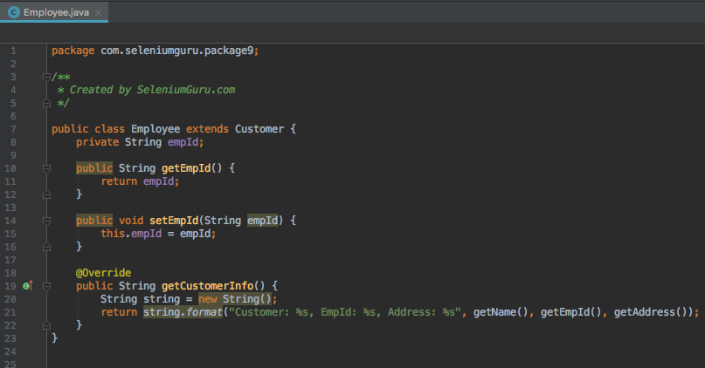
Abstract Class Contd..

Slide 26
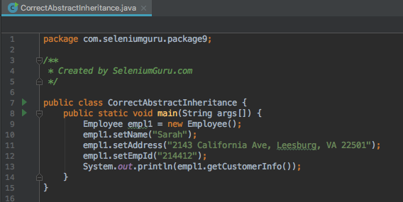
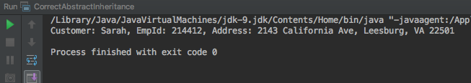
Abstract Class Contd..

Slide 27
Interface
Interface in Java is a reference type similar to a class but contain only signatures, default methods, static methods and nested types without containing any implementation inside the body.
Key features of Interfaces
All the methods inside the Interface is empty or does not have any implementation.
Interface cannot be instantiated just like abstract class.
Interface does not contain any constructors.
All methods inside the interface are abstract.
All the instance fields must be declared both static and final.
Interface cannot be extended by another class but rather be implemented by other classes.
All the methods inside the interface has to be used if implemented by other classes.
Interface is implicitly abstract so need to use abstract keyword.
Interface has only abstract methods so need not use abstract keyword for methods.

Slide 28
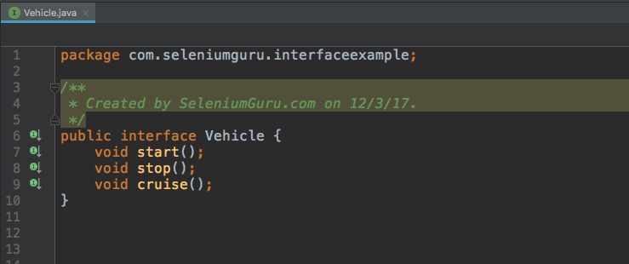
Interface Contd..

Slide 29
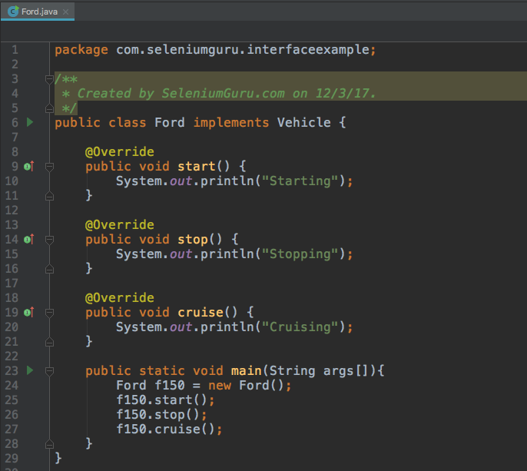
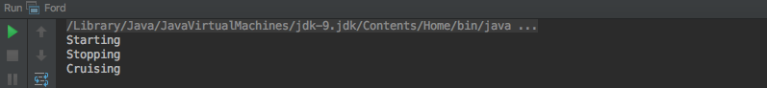
Interface Contd..

Slide 30
Collections
A Collection is a group of individual objects represented as a single unit.
Java provides Collection Framework which defines several classes and interfaces to represent a group of objects as a single unit.
The Collection interface (java.util.Collection) and Map interface (java.util.Map) are two main root interfaces of Java collection classes.
Collections provides consistent API as API has set of interfaces like Collection, Set, List or Map.
Collections reduces programming effort as it eliminates headache of design of collection.
Increases speed and quality providing high performance.

Slide 31
List
List is an ordered collection of objects in which duplicate values can be stored.
List allows positional access and insertion of elements.
List is the child interface of Collection.
List Interface is implemented by ArrayList, LinkedList, Vector and Stack classes.
List a1 = new ArrayList(); //Create ArrayList
List a2 = new LinkedList(); //Create LinkedList
List a3 = new Vector(); //Create Vector

Slide 32
ArrayList
ArrayList uses a dynamic array for storing the elements.
It inherits AbstractList class and implements List interface.
ArrayList can contain duplicate elements.
ArrayList maintains insertion order.
Non-Generic Array List can contain any type of objects.
Generic ArrayList allows you to have one type of objects in the collection.
List elements can be traversed using iterator interface or by for each loop.
ArrayList list1 = new ArrayList(); //Non generic Array List
ArrayList<String> list2= new ArrayList<String>(); //Generic ArrayList

Slide 33
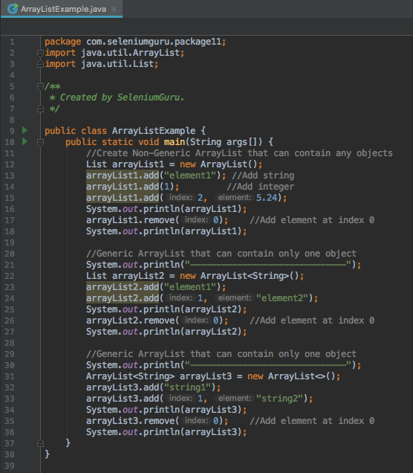
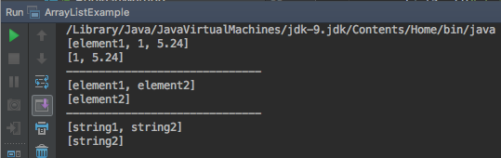
ArrayList

Slide 34
LinkedList
LinkedList also inherits AbstractList class and implements Deque interface.
LinkedList also can contain duplicate elements.
LinkedList also maintains insertion order.
LinkedList is slow compared to ArrayList since it takes time to traverse the list.
LinkedList<String> linkedList1 = new LinkedList<String>();

Slide 35
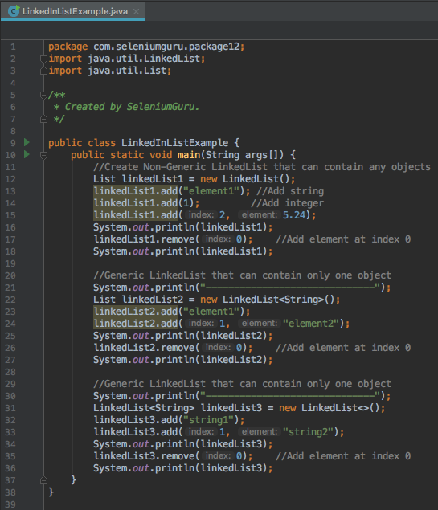
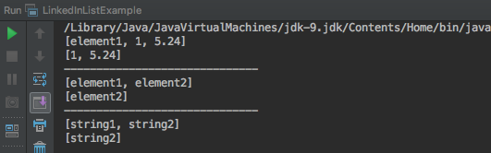
LinkedList

Slide 36
Vectors
Vectors are dynamic arrays.
Arrays once created, you cannot add or remove elements but Vector allows you to add or remove elements at run time.
You can create vectors by importing java.util.Vector class and create an object from Vector class.
You can create vector object with n number of elements and then add/remove elements onward.

Slide 37
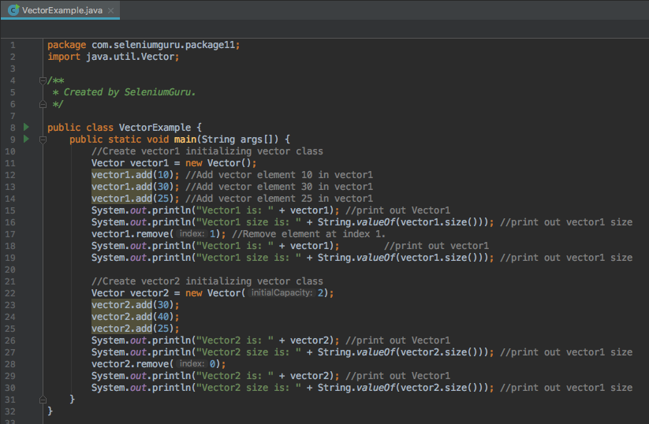
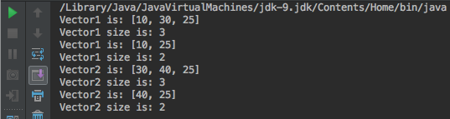
Vectors

Slide 38
Access Modifiers
Access Modifiers in Java specifies accessibility of a data member, method, constructor or class.
There are four types of java access modifiers.
default
private
protected
public
 | Default | Private | Protected | Public
Same class | Yes | Yes | Yes | Yes
Same package | Yes | No | Yes | Yes
Same package non-subclass | Yes | No | Yes | Yes
Different package subclass | No | No | Yes | Yes
Different package non-subclass | No | No | No | Yes

Slide 39
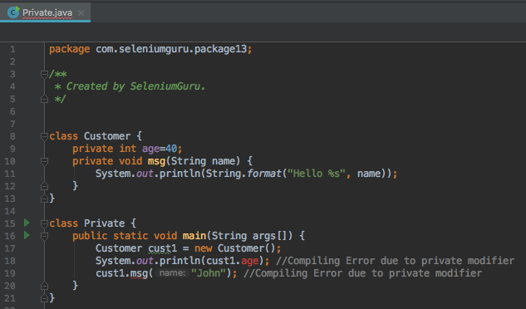
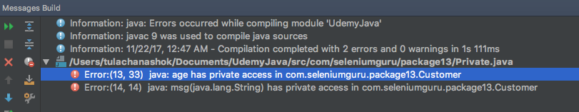
Private Access Modifier
Private: Only accessible within class.

Slide 40
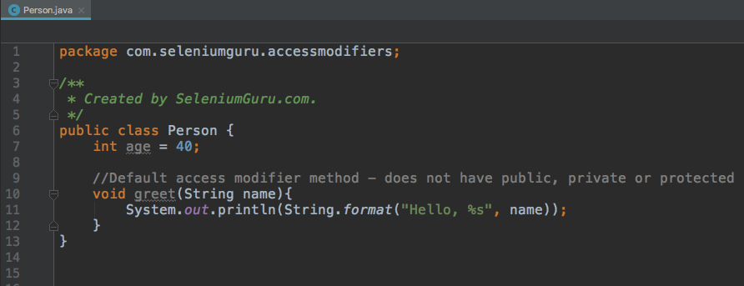
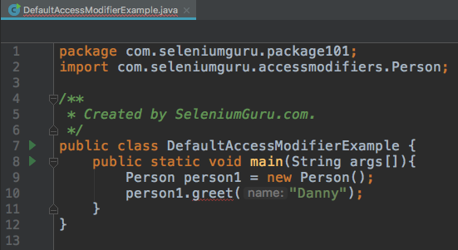
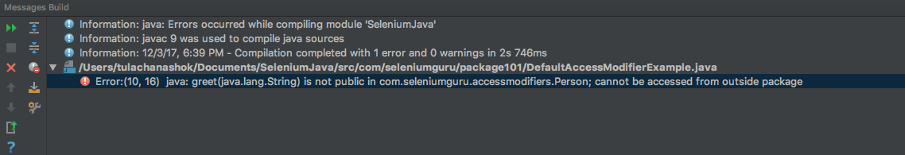
Default Access Modifier
Default: Only accessible within class and package.

Slide 41
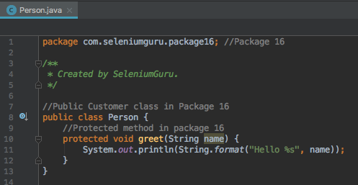
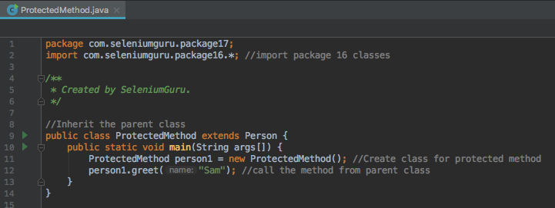
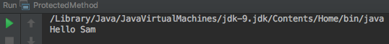
Protected Access Modifier
Protected: Accessible within package and outside the package but through inheritance only. The protected access modifier can be applied on the data member, method and constructor. It can't be applied on the class.

Slide 42
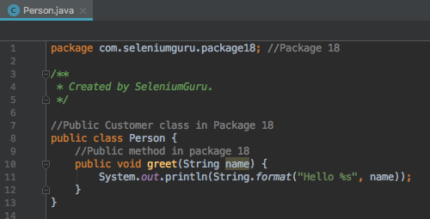
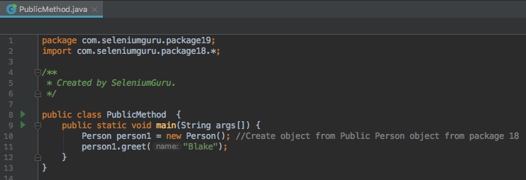
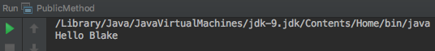
Public Access Modifier
Public: Accessible everywhere. It has the widest scope among all other modifiers.

Slide 43
Exception Handling
Exception occurs during the execution of the program due to bug in code or system failure.
Exception in Java are normally of two types.
Checked Exceptions:
Checked Exceptions occurs at the compile time, these are also called as compile time exceptions. These exceptions cannot simply be ignored at the time of compilation which means the programmer should take care or handle these exceptions.
Example: Reading file that doesn’t exist.
Unchecked Exceptions:
An unchecked exception is an exception that occurs at the time of execution. These are also called as Runtime Exceptions. These include programming bugs, such as logic errors or improper use of an API. Runtime exceptions are ignored at the time of compilation.
Example: Reading the 6th element in 5 element array.

Slide 44
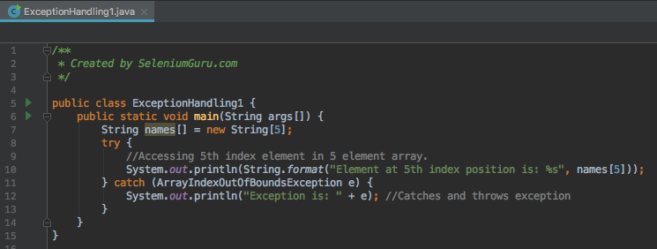
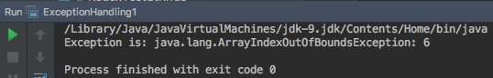
Exception Handling
Exception Handling in Java is done with try/catch block where the exception are caught in the catch block.

Slide 45


Exception Handling
You can also declare Exception on method instead of using try/catch block.

Slide 46


Exception Handling
You can execute your code/statement with Finally block along with try/catch block. Finally block always executes irrespective of occurrence of an exception.

Slide 47
File IO
All I/O methods are derived from class java.io.
File Input/Output in Java are performed using stream.
A stream can be defined as a sequence of data. There are two kinds of streams −
InPutStream − Used to read data from a source.
OutPutStream − Used for writing data to a destination.
There are various streams that can be used to do I/O functions in Java.
Byte Streams – Used to perform input and output of 8 bytes.
Mostly Commonly used is FileReader and FileWriter class.
Character Streams: Used to perform input and output of 16 bytes.
Mostly Commonly used is FileInputStream and FileOutputStream class.
Standard Streams: Standard stream to provide standard I/O where the user can take input from keyboard and produce output in computer screen.
Mostly Commonly used is System.in, System.out and System.err.

Slide 48


File IO - ByteStream

Slide 49


File IO – ByteStream Contd..

Slide 50

File IO - CharacterStream

Slide 51


File IO – CharacterStream Contd..

